Slide 1
Advanced AB testing in practice
By: Eltsefon Mark

Slide 2





Acceleration. Sample Size
Minimum detectable effect
Variance
Critical value for alpha / 2
Critical value for beta

Slide 3
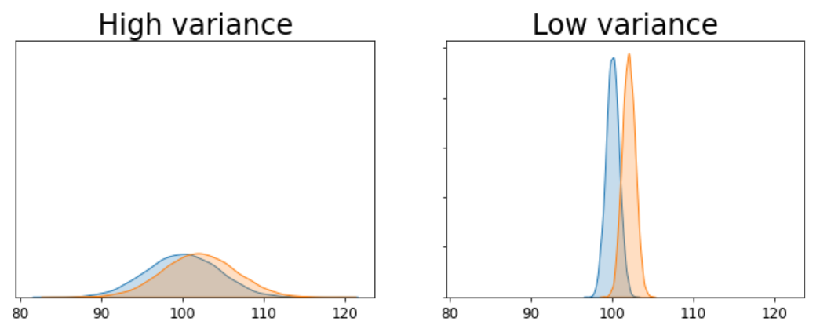
Acceleration. Intuition

Slide 4
Acceleration. Simple approaches
Change metric
Eliminate outliers
Box-cox transformation

Slide 5
Acceleration. Change metric
Revenue
Average revenue
DAU
Average Number of payments
Average check
Average session length
Retention

Slide 6
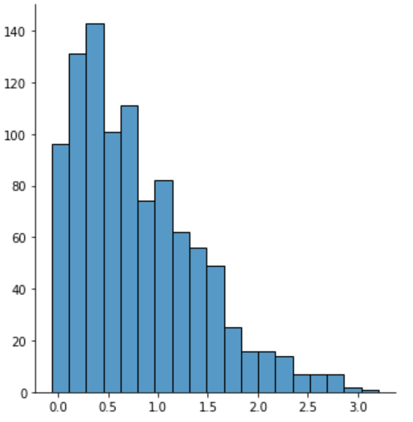
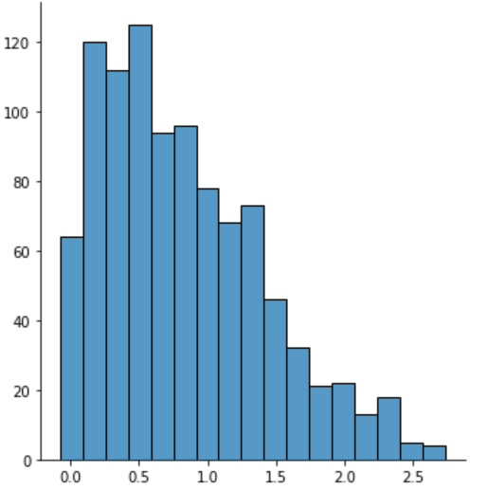
Acceleration. Eliminate outliers
Variance decreased by a factor of 1.2

Slide 7
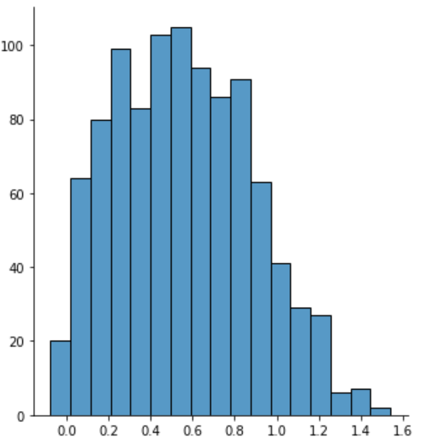
Acceleration. Box Cox transformation
Variance decreased by a factor of 4!

